Slide 1
Estimating the Size of the Web
000 Dik Lun LEE Department of Computer Science, HKUST Slide <number>

Slide 2
Sizing the Web
The exact size of the web is unknown: Different measuring techniques give different results
It is believed that the size is doubling every year:
  50 million pages in November 1995
  320 million pages in December 1997
  800 million pages in February 1999
  estimated to be over 1 billion in February 2000
  2.1 billion pages indexed by Google (2003)
  2.3 billion pages indexed by Alltheweb (2003)
  3.3 billion pages index by Google (8/2003)
  3.5 billion pages indexed by Openfind (2003)
  8 billion pages indexed by Google (9/2004)
  20 billion: 19.2 b web pages, 1.6 b images, 50 m audio/video (8/2005)
    Google stopped releasing its size
000 Dik Lun LEE Department of Computer Science, HKUST Slide <number>

Slide 3
How to Measure the Size?
There are currently 256^4 (about 4.3 billion) possible IP addresses
Random IP addresses are chosen and tested for a web server at the standard port
Total number of servers is estimated according to the fraction of tests that successfully locate a server
  if y out of x IP addresses tried lead to a valid web server, then the total number of web servers = 4.3 billion * y/x
Count all the web pages in the first 2,500 random web servers
Use the mean number of web pages/server and the number of estimated web servers to estimate the number of web pages on Internet
S. Lawrence and L. Giles, “Accessibility of information on the web”, Nature, 1999
A report by NEC researchers.
000 Dik Lun LEE Department of Computer Science, HKUST Slide <number>

Slide 4
Other Interesting Results
Size of the web: 800 million indexable pages and 180 million images
Large number of dead links in search results: 3% up to 15%
Number of publicly indexable web servers = 2.8 million
Mean number of pages per server = 289 (highly skewed)
Amount of data = 15 Terabytes (6 Tbytes of textual contents)
000 Dik Lun LEE Department of Computer Science, HKUST Slide <number>

Slide 5
Other Interesting Results
Delay between the last modification/creation time of a web page and the time it is indexed by a search engine is close to 6 months
The chance that a site is indexed by a search engine is dependent to the number of links pointing to the site
  3-4 times higher in probability for sites with 20 links or more pointing to it comparing to those having only 1 link to it
  if there are more paths leading to the site, the chance for a spider to crawl to the site is higher
  could be the search engine’s strategy to give high weight to popular sites
000 Dik Lun LEE Department of Computer Science, HKUST Slide <number>

Slide 6
Estimation on Web Size and Search Engine Overlap
How to find out which search engine is largest?
  Issue queries to the search engines and see and compare the sizes of the result sets
  Relatives sizes of result sets ⇒ Relative sizes of the search engines
More accurate: Consider overlaps in search engine results; not just comparing sizes of the result sets
Basic idea:
  If two independent crawlers result in two sets of pages that are largely disjoint, we can infer that the web is likely to be a lot larger than the union of the two sets of pages
  If the two sets have a large overlap, then the web is likely not a lot larger than the union
000 Dik Lun LEE Department of Computer Science, HKUST Slide <number>

Slide 7
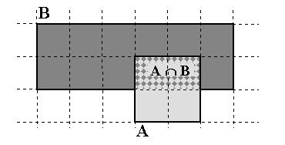
The Digital SRC Report (1997)
Try to estimate the total coverage of search engines
  Pr(A) = probability of an element belong to set A
  Pr(A & B|A) = probability of an element belong to both A & B given that it belongs to A example
  Pr(A & B|A) = | A ∩ B| / |A| 1/2
  Pr(A & B|B) = | A ∩ B| / |B| 1/6
  |A| / |B| = Pr(A & B|B) / Pr(A & B|A) 1/3
  How to find Pr(A & B|B) and Pr(A & B|A)?
The relative size of two search engines E1 and E2:
Fraction of E2’s results found in E1’s results
Fraction of E1’s results found in E2’s results
000 Dik Lun LEE Department of Computer Science, HKUST Slide <number>

Slide 8
Relative Coverage of Search Engines?
Issues random (but real-world) queries to the search engines and measures the number of pages found at each search engine (2500 queries were used)
If we know the relative coverage of the search engines and the actual number of pages of one search engine, we can find out the coverage of a search engine with respect to the size of the web. E.g.,
Rel size Actual size
Engine 1: 0.9 estimate
Engine 2: 0.5 1 billion (known)
Engine 3: 0.4 estimate
000 Dik Lun LEE Department of Computer Science, HKUST Slide <number>

Slide 9
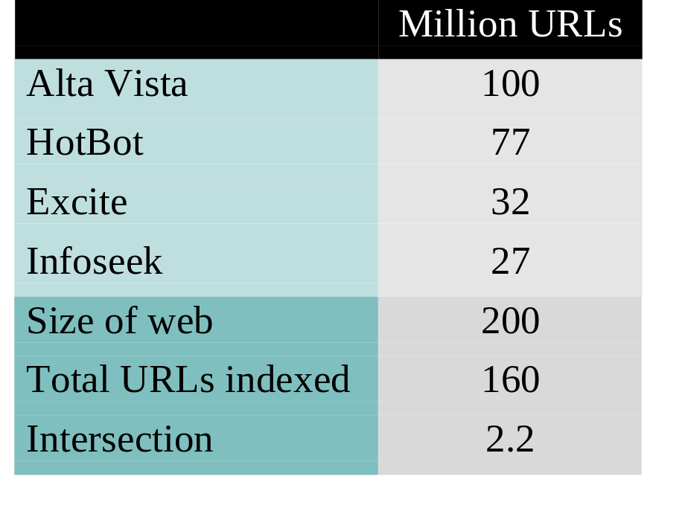
The Digital SRC Report (1997)
Reference:
The Digital SRC Report (1997)
http://www.research.digital.com/SRC/whatsnew/sem.html
000 Dik Lun LEE Department of Computer Science, HKUST Slide <number>

Slide 10
Update in Early 2005
440,000 one-term queries are issued to Google, MSN, Yahoo and Ask
  75 languages are used in the queries
The four search engines covered from 2 billion to 5 billion pages
Intersection was 3 billion pages and union 9 billion
The web is estimated to have 11.5 billion pages
A. Gulli, and A. Signorini The indexable web is more than 11.5 billion pages International World Wide Web Conference Special interest tracks and posters of the 14th international conference on World Wide Web Chiba, Japan, 2005.
000 Dik Lun LEE Department of Computer Science, HKUST Slide <number>

Slide 11
Source of Errors
It is hard to tell if two URLs point to the same page or not
  Two different URLs can point to the same page (leading to over estimation)
  The same URL may point to different pages at different time (e.g., the home page …/index.html of a news website always point to “today’s news” which changes every day
The crawlers may not be completely independent because most of them use “similar crawling strategies” (e.g., starting with popular sites such as Yahoo Directory or Open Directory and use breadth-first crawling)
  What is the effect on the estimation?
000 Dik Lun LEE Department of Computer Science, HKUST Slide <number>

